Slide 1
Learning Relational Dependency Networks for Relation Extraction
Ameet Soni, Dileep Viswanathan, Jude Shavlik, and Sriraam Natarajan

Slide 2
Knowledge Extraction
Given
Large corpus of unstructured text
List of target relations
Goal
Compute probability of relation existing between entities

Slide 3
Motivating Task - TAC KBP
Knowledge Base Population - automatic construction of knowledge base from unstructured text

Slide 4
Motivating Task - TAC KBP
Knowledge Base Population - automatic construction of knowledge base from unstructured text
Sentence:
“President Barack Obama, 55, attended the event with wife Michelle Obama”

Slide 5
Motivating Task - TAC KBP
Knowledge Base Population - automatic construction of knowledge base from unstructured text
Sentence:
“President Barack Obama, 55, attended the event with wife Michelle Obama”
Knowledge:
spouse(Barack Obama, Michelle Obama)
age(Barack Obama, 55)
title(Barack Obama, President)

Slide 6
TAC-KBP Challenges
Large scale – over 300GB of data
No labeled data
High degree of uncertainty
Extracting structure from unstructured text

Slide 7
System Overview
Train corpus
Features
CRF/MRF/Deep/Deeper/Deepest
Training Labels
Learned models
Features
Test corpus
p(y|x)

Slide 8
Contributions
RDN Boost algorithm on benchmark Relation Extraction task
Joint learning of target relations
Weak supervision through knowledge rules
word2vec relational features
Incorporating human advice

Slide 9
System Overview
Features
Train corpus
Stanford NLP facts
word2vec
Boosted RDN learner
Advice
Training Labels
Weakly supervised
Gold annotations
Learned models
Features
Test corpus
Knowledge rules
p(y|x)

Slide 10
Dependency Network
Approximate the joint distribution over the variables as a product of conditional distributions
P(A,P,C,D) ≈ P(D|C,A) × P(C|A,P) × P(A|D) × P(P|C,D)
Even, with the approximation, no closed form solution
Typically, Gibbs sampling is used
P(D|C,A)
Difficulty
Course rating
Prof rating
P(C|A,P)
P(P|C,D)
Average grade
D. Heckerman et al., JMLR 2001
P(A|D)

Slide 11
Relational Dependency Network (RDN)
Extend dependency networks to relational domains
Random variables are Objects and Relations
Aggregators (eg. count) handle multiple instance problem
Learning RDNs correspond to learning CPDs
Relational Probability Trees (RPTs) represent CPDs
Each RPT learned independently
Inference - Gibbs Sampling
Neville & Jensen ‘07

Slide 12
RDN Example
Aggregator
Student(S)
Professor(P)
Level(P,L)
avgSGrade(S,G)
IQ(S,I)
satisfaction(S,B)
avgCGrade(C,G)
taughtBy(P,C)
takes(S,C)
ratings(P,C,R)
grade(S,C,G)
Course(C)
Difficulty(C,D)

Slide 13
Gradient (Tree) Boosting [Friedman Annals of Statistics 29(5):1189-1232, 2001]
Models = weighted combination of a large number of small trees (models)
Intuition: Generate an additive model by sequentially fitting small trees to pseudo-residuals from a regression at each iteration…
Data
Data
+
-
=
Residuals
Loss fct
Induce
+
Predictions
Initial Model
Iterate
+
Final Model =
+
+
+
+
+
…

Slide 14
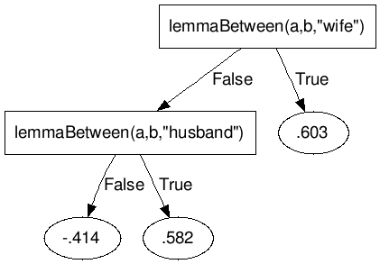
Gradient (Tree) Boosting [Friedman Annals of Statistics 29(5):1189-1232, 2001]
Models = weighted combination of a large number of small trees (models)
Intuition: Generate an additive model by sequentially fitting small trees to pseudo-residuals from a regression at each iteration…
Data
Data
+
-
=
Residuals
Loss fct
Induce
+
Predictions
Initial Model
Iterate
+
Final Model =
+
+
+
+
+
…

Slide 15
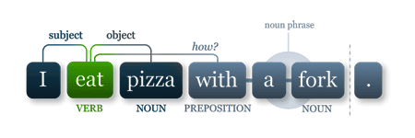
Feature Extraction Pipeline
Corpus
First order logic
facts generator
entityTye(a,”PER”)
prevLemma(“Obama”,””age”)
Nextword(“Barack”,”Obama)
…
RDN Boost

Slide 16
NLP Features
Part of speech
Noun, Verb, Adj, etc.
Word lemma
sitting::sit
ate::eat
Adjacent words
next and previous words
Named Entity Tag
Tom::Person
LA::City
Dependency path
root word, child of root, etc.

Slide 17
word2vec features
Goal: detect similarities in the linguistic context of words
Each word is represented as a vector-space embedding
Words with similar contexts have high (cosine) similarity
Approach: introduce word2vec features in relational context. Learn basket of words with similar contexts as target relation (e.g., father, dad, mother, mom)
isCosineSimilar(target_word, cur_word, threshold)
entity(A) ^ entity(B) ^ wordInBetween(C) ^ isCosineSimilar(‘father’, C, 0.75) → parent(A,B)

Slide 18
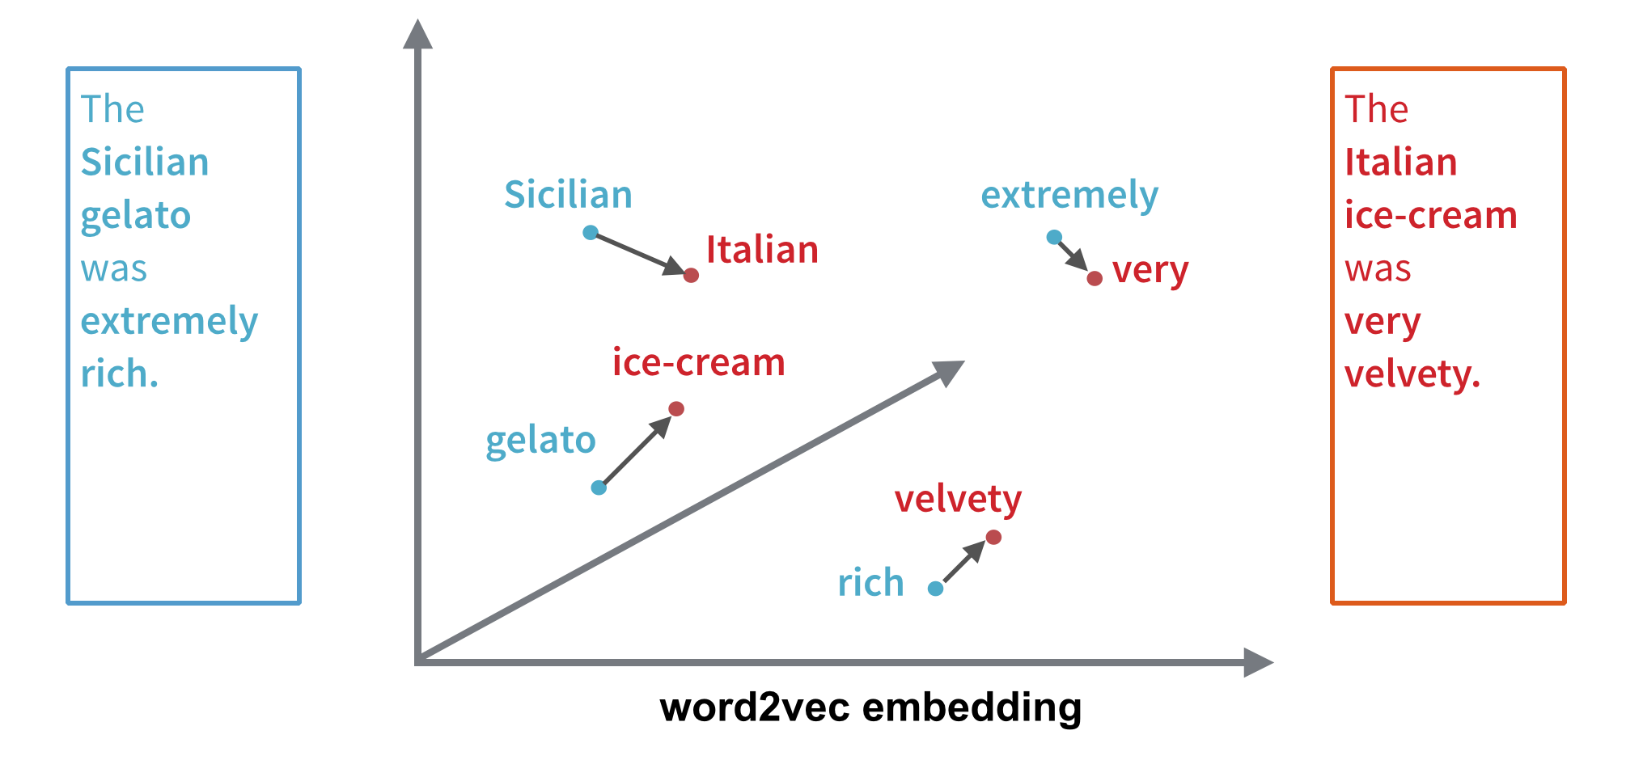
Feature Extraction Pipeline
Corpus
First order logic
facts generator
entityTye(a,”PER”)
prevLemma(“Obama”,””age”)
Nextword(“Barack”,”Obama)
…
RDN Boost

Slide 19
Joint Learning
RDNs can learn multiple target relations jointly
TAC KBP contains multiple targets with strong correlations
E.g., spouse(A,B) and spouse(B,A); parent(A,B) and child(B,A)
Joint inference can detect relations despite weak evidence
Example “Barack and Michelle’s daughter, Malia Obama, is taking a gap year before beginning college”
Individual inference: positive for child; positive for parent
Joint inference: positive for spouse

Slide 20
Incorporating Human Advice
Humans can benefit model construction beyond mere labelling of examples
Odom et al. (2015) demonstrated a successful approach to incorporating human advice in the RDN Boost algorithm
Advice influences the calculation of gradients
Learned trade-off between data and advice
Entity1 is “also known as” Entity2 probably refers to alternate name.

Slide 21
Weak Supervision
Manually labeling target relations is prohibitively expensive
Weak supervision - automatically identify training examples with some noise (silver standard examples)
Knowledge-based weak supervision
Encode intuition of human labelers in FOL format; weights indicate confidence
Construct MLN to perform inference on unlabeled corpus
Inferred positives (with probabilities) become training labels
Shown to be superior to distant supervision [ILP 2013]
entityType(a, “PER”), commaAfter(a), nextWord(a,b), entityType(b, “NUM”) → age(a,b)

Slide 22
System Overview
Features
Train corpus
Stanford NLP facts
word2vec
RDN Boost
Advice
Training Labels
Weakly supervised
Gold annotations
Learned models
Features
Test corpus
Knowledge rules
p(y|x)

Slide 23
Experimental Methodology
Data: TAC KBP corpus (train on 2014; test on 2015)
14 target relations
10 person relations
4 organization relations
Experiments:
RDN Boost vs Relation Factory [Roth et al] (2013 KBP champion)
Joint learning vs individual learning
RDN + word2vec
RDN + Advice
RDN + Weak supervision

Slide 24
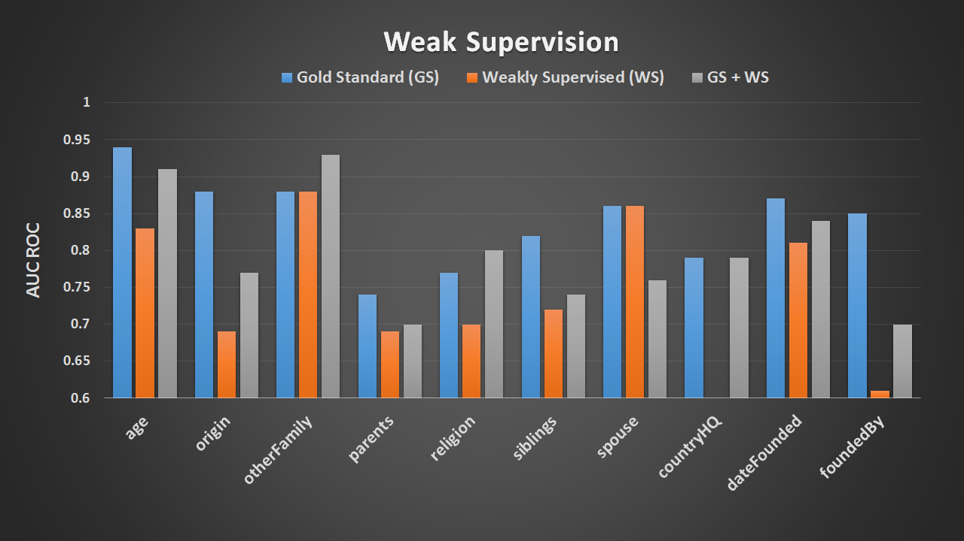
WS + 20 GS examples is mostly able to replace full GS training set

Slide 25
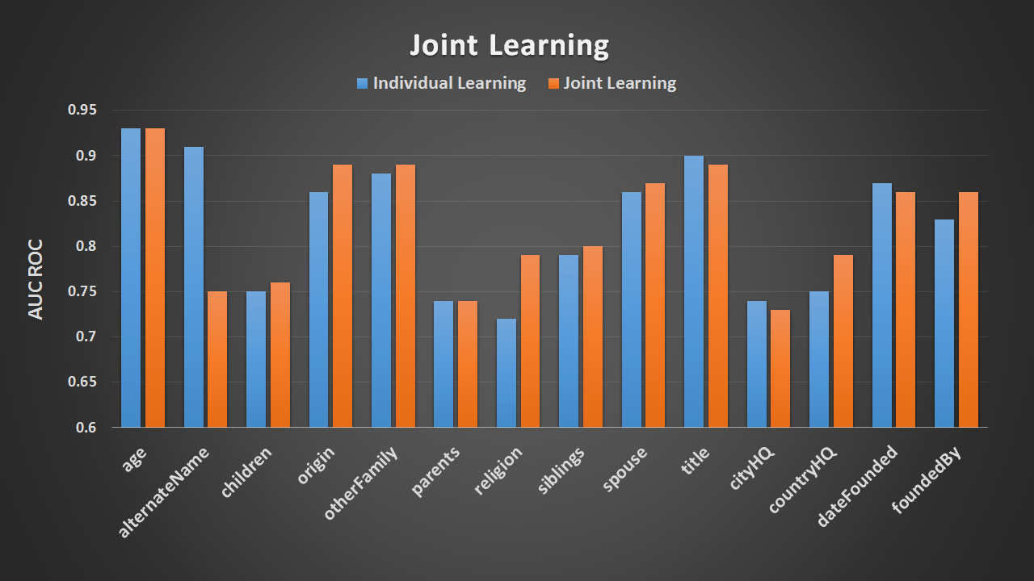
Joint learning improves performance when target relations are connected

Slide 26
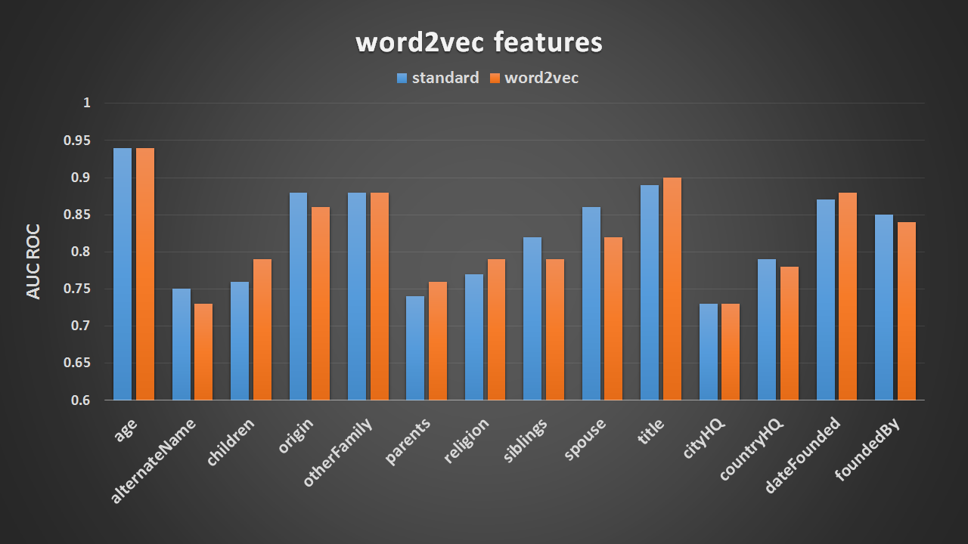
word2vec does not improve performance

Slide 27
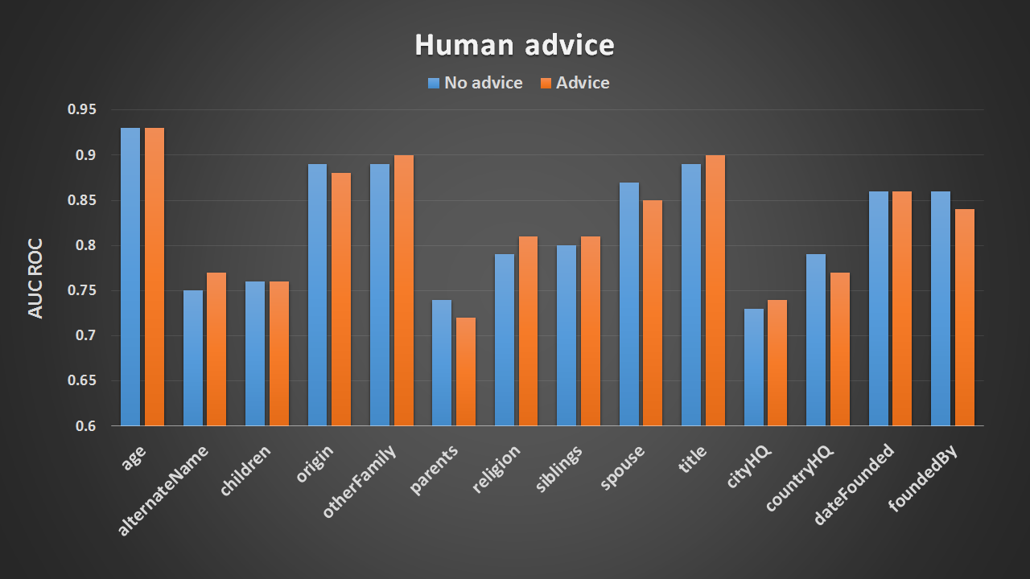
Advice improves performance (particularly recall)

Slide 28
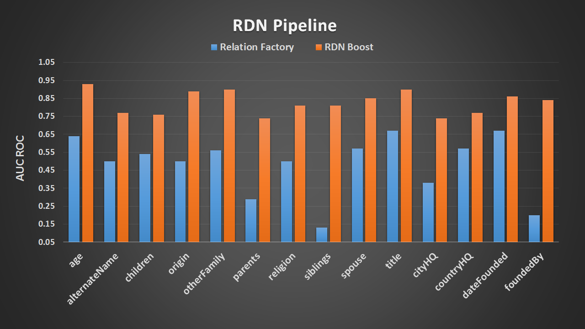
RDN (the full system) outperforms a state-of-the art system on KBP

Slide 29
Conclusions
Weak supervision helps when supplemented with few gold examples
Joint learning performs well for connected relations
Results do not favor word2vec features over standard features
Use of human advice improves performance over learning from just data
RDN performs better than the state-of-the-art relation extraction system

Slide 30
Future Work
Expand our established framework for word2vec in relation domain
Compare RDN to other relational algorithms – Word embeddings using Problog
Expand to all KBP target relations

