Slide 1
Characterization Methods for SET Cards Using Image Processing
Benjamin Marks
Summer Ventures in Science and Mathematics 2011
Appalachian State University

Slide 2
What is SET?
Card Game
Card Characteristics
Sets
Three cards
Each feature is either the same on each card or is different on each card

Slide 3
Some Examples

Slide 4
Is it possible to recognize the characteristics of a SET card with Image Processing?

Slide 5
Color
Pixel RGB values (0-255)
Skip white pixels
When are some colors present in higher intensity than others?

Slide 6
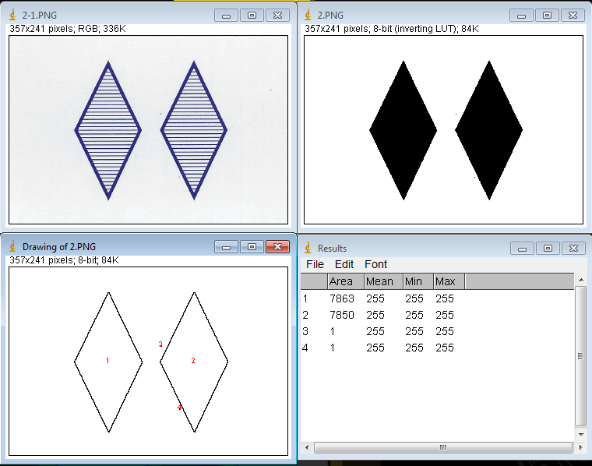
Number
How many contiguous groups of pixels are present?
Minimum number of pixels to be a shape

Slide 7
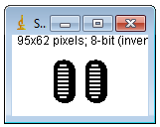
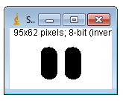
Shape
Holes Filled
Each pixel has a value (0 or 1)
How many pixels are associated with shapes?
Ratio of pixels in 1 shape to total pixels in image

Slide 8
Shading
Holes Filled
How much did we need to fill in?
$\frac{How many pixels were filled}{How many pixels are in the entire shape}$

Slide 9
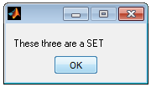
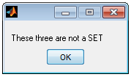
Is it a SET?
Are all 4 characteristics the same or different on all 3 cards?

Slide 10
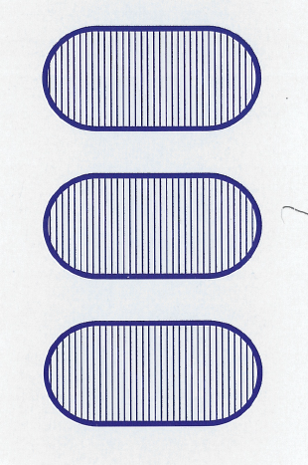
Sets and Image Processing
Is it possible?
Yes
81/81 cards downloaded from SET website successfully interpreted
36/36 scanned cards successfully interpreted
Sets and Non-Sets successfully classified

Slide 11
Detecting Card Characteristics

Slide 12
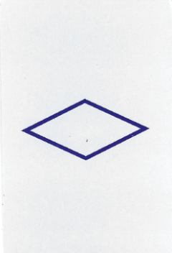
Detecting a SET

Slide 13
Further Research
More versatile
Solving Sets?

Slide 14
References
Belongie, S., Malik, J., & Puzicha, J. (2002). Shape Matching and Object Recognition Using Shape Contexts. IEEE Computer Society, 509-522.
Grimson, W. E. (1991). Object Recognition by Computer; The Role of Geometric Constraints. The MIT Press Classics Series.
How to Play Set®; Rules and Overview. (n.d.). Retrieved July 26, 2011, from SET: http://setgame.com/set/rules_set.htm
Parker, J. R. (1996). Algorithms for Image Processing and Computer Vision. Wiley.

Slide 15
Acknowledgements
Dr. Rahman Tashakkori
Mr. Dale Henries
Mr. Ahmad Ghadiri
Ms. Lori Tyler
Summer Ventures in Science and Mathematics
Appalachian State University
2011

